Slide 1
Coffee Shop Sales Dashboard

Slide 2
Objective
Analyse business performance trends.
Identify peak customer behaviour.
Understand product preference patterns.
Support data-driven decisions.

Slide 3
Dashboard Overview
Built using Excel, combining charts for comprehensive analysis.
Tracks hourly trends, category split, size preference, store rank.
Single view enabling quick decision-making.
Improves understanding of customer and product performance.

Slide 4
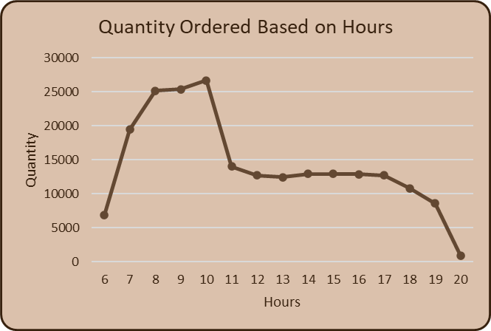
Quantity vs Hours (Line Chart)
Line chart shows hourly demand patterns throughout the day.
Identifies rush hours; crucial for resource planning.
Morning and evening peak hours show strong customer flow.
Low mid-day traffic indicates promotional opportunity.

Slide 5
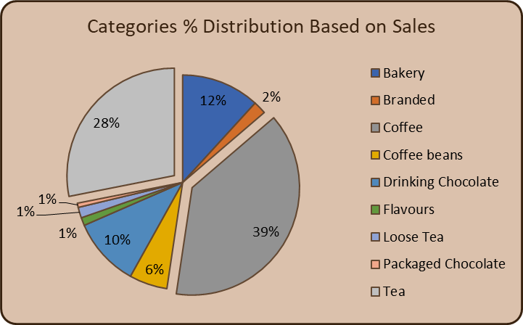
Category % Distribution (Pie Chart)
Pie chart highlights proportional contribution by category.
Coffee dominates nearly 50% of total sales.
Helps prioritize inventory and promotional strategies.
Offers clarity in understanding customer taste preferences.

Slide 6
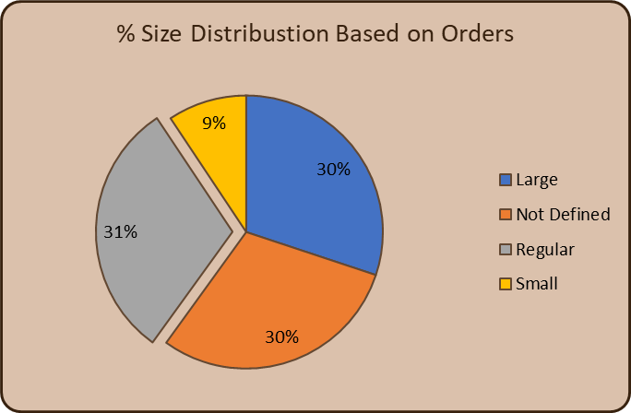
Size Distribution (Pie Chart)
Shows serving size preferences among customers.
Small size at 50%—price-sensitive customer base.
Regular & Large sizes show growth opportunity.
Useful for portions & pricing strategy.

Slide 7
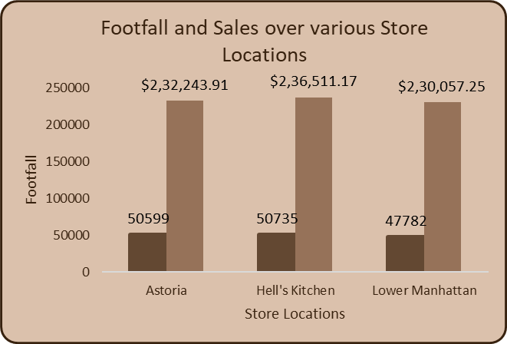
Store Footfall & Sales (Bar Chart)
Compares store performance based on customer visits & revenue.
Grand Total store performs best; high traffic + high sales.
Guides resource allocation like staffing, stock distribution.
Indicates performance gaps across multiple locations.

Slide 8
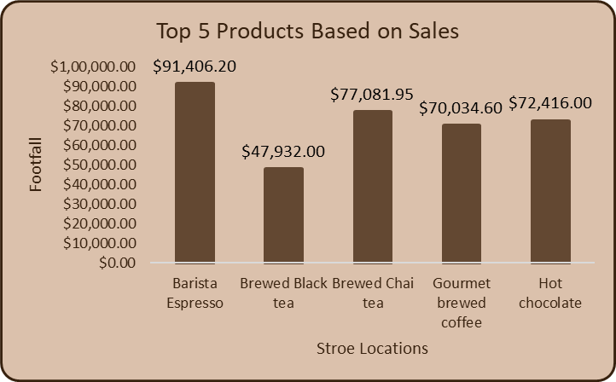
Top 5 Products (Bar Chart)
Shows top-performing products driving maximum revenue.
Barista Espresso highest-selling product.
Gourmet brewed coffee & hot chocolate add steady revenue.
Supports SKU optimization & marketing focus.

Slide 9
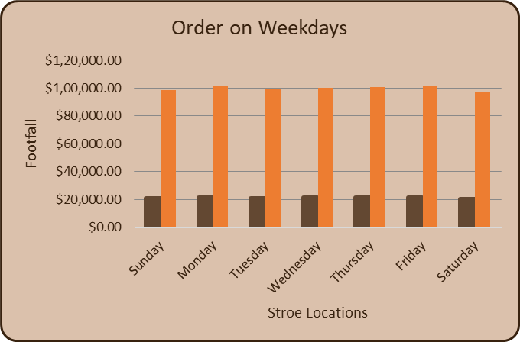
Orders by Weekdays (Bar Chart)
Compares demand across weekdays to find customer trends.
Weekend sales slightly higher; weekday performance stable.
Helps manage workforce scheduling efficiently.
Offers insights to plan weekly promotions.

Slide 10
Conclusion
Coffee & small products lead sales
Demand varies by hour & location
Insights guide stocking & marketing
Dashboard enables smarter planning .

